Slide 1
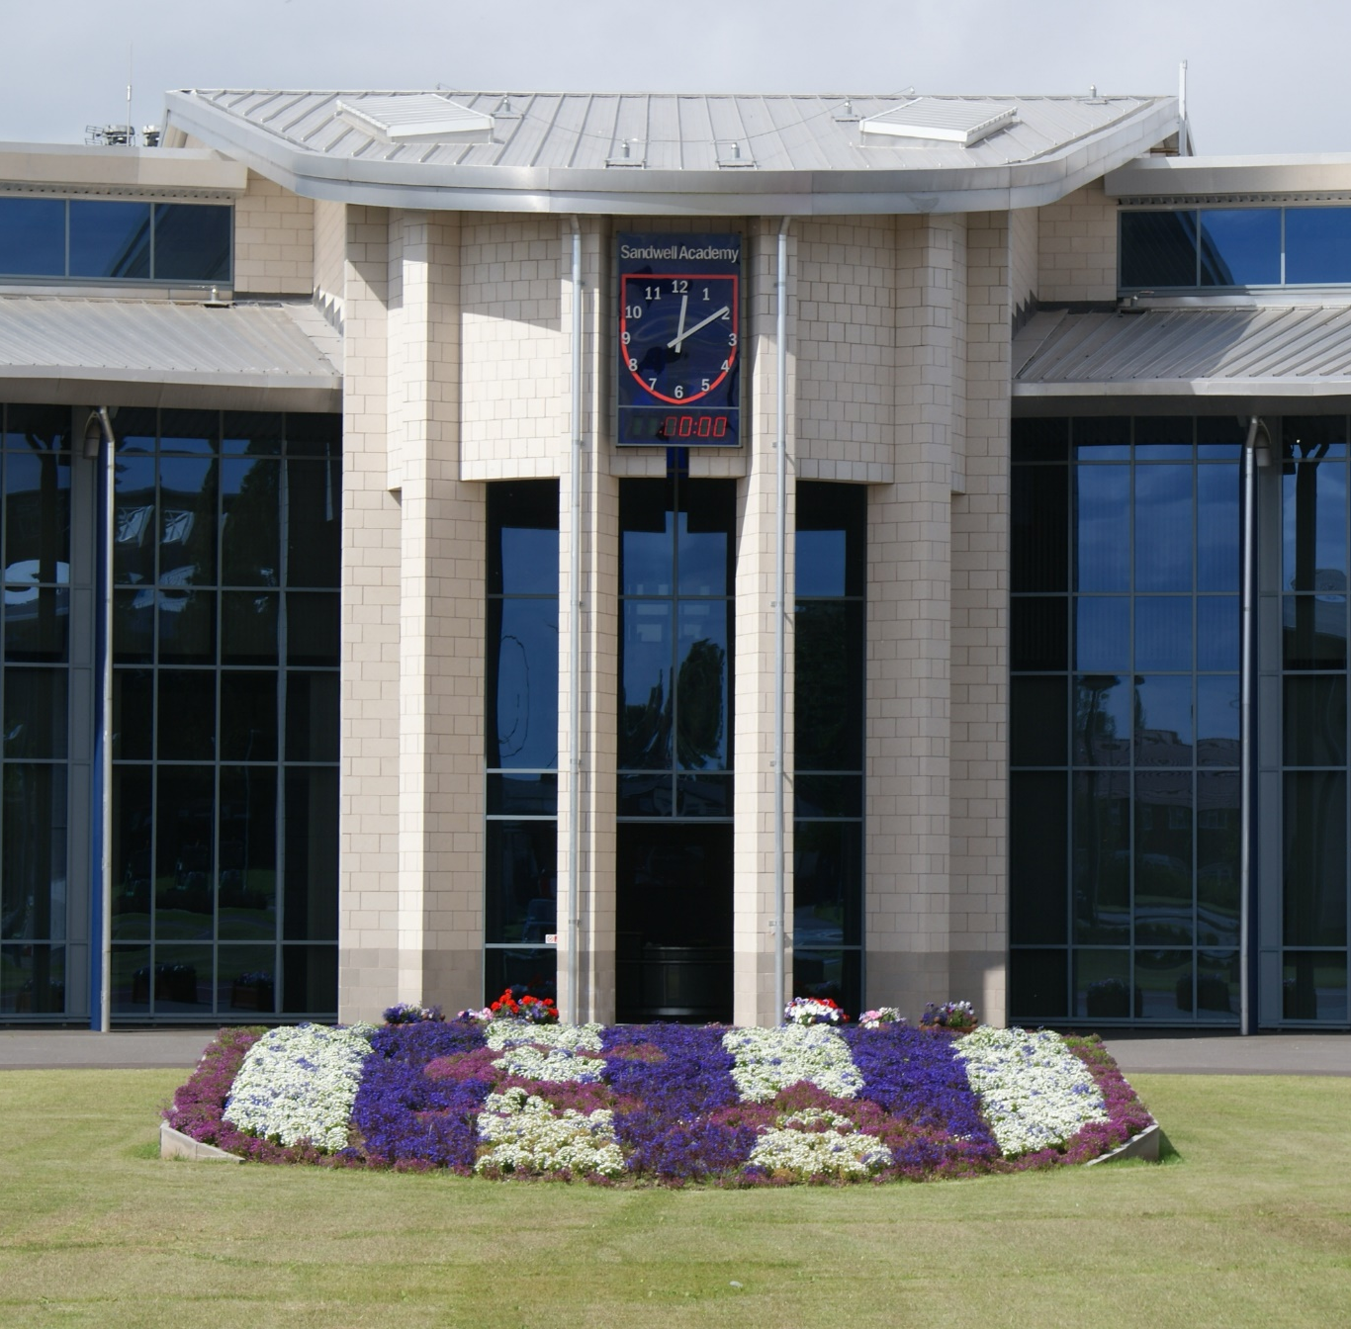

Sandwell Academy
Year 7 Information Evening
2024

Slide 2

Information Evening Schedule
Academy Review
Welcome – Mr Saunders, Headteacher
Vision and values – Mr Saunders, Headteacher
Student characteristics and Parent partnerships – Mr Saunders, Headteacher
Settling in – Mrs. Chapman, Deputy Head
Attendance and Behaviour – Mrs. Chapman, Deputy Head
Induction day arrangements – Ms. White, Head of Year 7
Be Brave, Be Kind, Be Proud

Slide 3
Academy Review
Be Brave, Be Kind, Be Proud

Slide 4
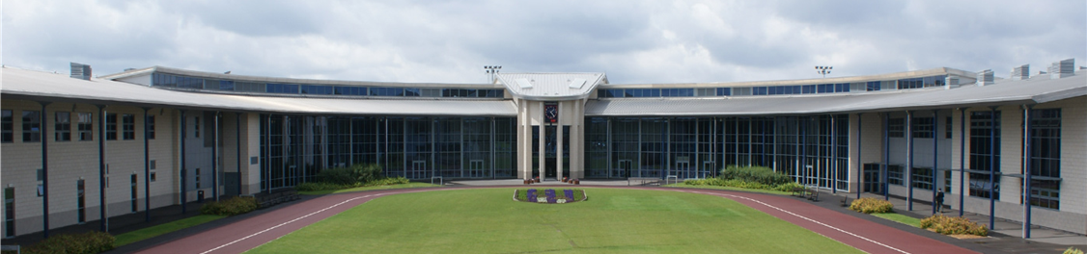
Academy Welcome
Mr Saunders
Headteacher
Be Brave, Be Kind, Be Proud

Slide 5

My Child At School (MCAS)
An online information portal for parents/carers to be able to access student information.
Be Brave, Be Kind, Be Proud
Notes:
You will be able to view your child's behaviour, attendance and recent reports. Additional information, such as their timetable, lessons and teachers are also available.
As a Parent or carer you will be provided with a username and password for this system.

Slide 6

The Parent and Student Charter
Be Brave, Be Kind, Be Proud
Notes:
The Academy does not have a long list of rules but the key ones are set out in the Student Charter.
A copy of this is printed in the student planner, students will read and sign this on their first day in September.
Parents/carers were sent a copy of the Parent Charter in March, with the offer letter. Please read and acknowledge this asap (Microsoft form link).

Slide 7
Student Code of Conduct
All day, every day students are expected to:
Behave in an orderly and self-controlled way
Show respect to members of staff and each other
In class, make it possible for all students to learn
Move quietly around the school
Treat the school buildings and school property with respect
Wear the correct uniform at all times
Accept sanctions when given
Refrain from behaving in a way that brings the school into disrepute, including when outside school
Be Brave, Be Kind, Be Proud
Notes:
The standards that are expected of Sandwell Academy students are set out in our Student Charter. This is documented in the students planner and every student signs to acknowledge that they have read and understood it on the first day of term.

Slide 8
Settling In
Mrs Chapman
Deputy Headteacher
Be Brave, Be Kind, Be Proud

Slide 9
Timings of the Academy Day
Arrival 7.45-8.45am
Start of session 8.20am
End of the day 3.20pm
After school session 3.40-4.50pm
Be Brave, Be Kind, Be Proud
Notes:
Academy gates open from 7.45am.
KS3 students make their way to restaurant and await the 8.15am bell to move to lessons.
KS4 students make their way to their Session 1 venues.
There are four taught sessions in the Academy day. They also have a personal tutor session in the middle of the day.
Breakfast break of 15 minutes each morning.
Lunch 40 minutes – 20 minutes in the restaurant and 20 minutes outside.
All students are encouraged to stay for one After School Session. A timetable will be published on the website for September. Late coaches are available for students on these days.

Slide 10








Personal Tutor Groups
Year | Astle | Archer | Cadbury | Fraser | Hadley | Regis | Tolkien | Walters
7 | 7 Astle | 7 Archer | 7 Cadbury | 7 Fraser | 7 Hadley | 7 Regis | 7 Tolkien | 7 Walters
Be Brave, Be Kind, Be Proud
Notes:
There are 8 houses at the Academy. You may recognise some of the names.
Your PT group will be part of one house. They are your “family” within the Academy.
As a PT students compete together as a House and will go to some classes as a PT group.
The Personal Tutor is the students main person in case of any worries, questions or problems. They are also the first point of contact for parents.
Different activities occur during the daily PT sessions. Each Monday students watch the Academy broadcast, this includes key messages, sports and house round up and whole school star student. Citizenship and PSHE curriculum is delivered in these session. Fridays focusses on celebrating the successes of the students.
There are House competitions throughout the year and rewards for winning Houses and individuals.

Slide 11
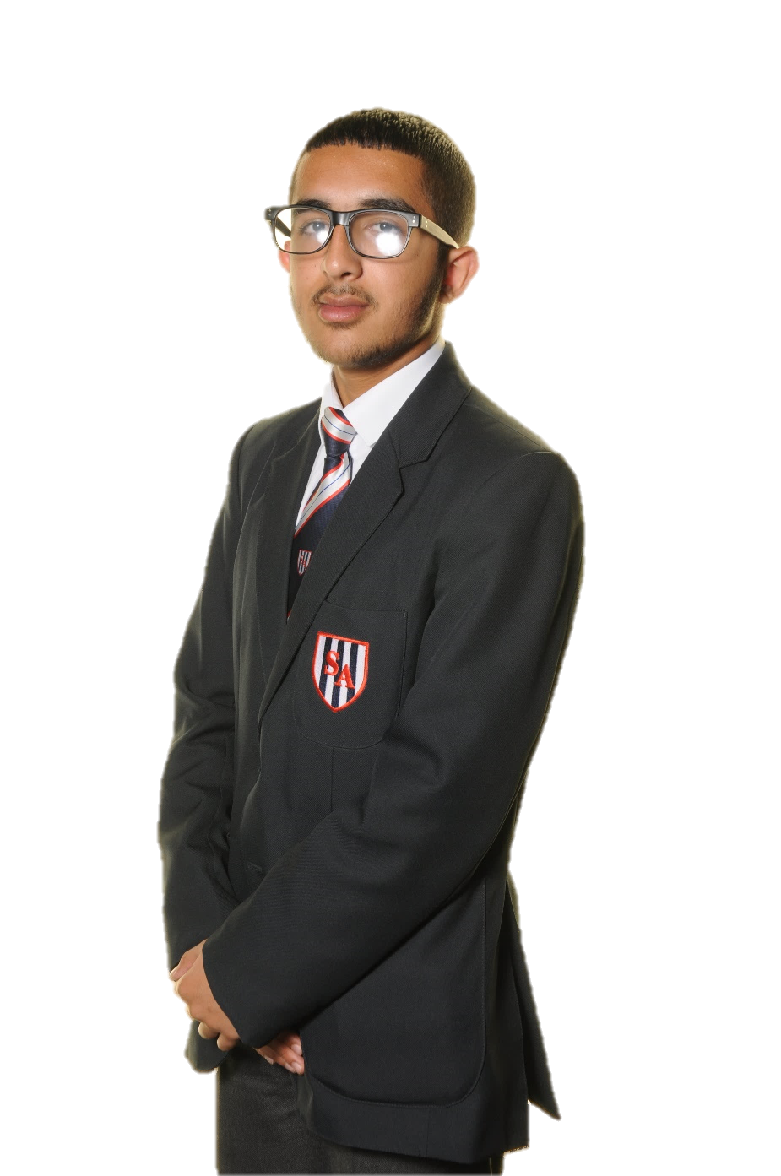
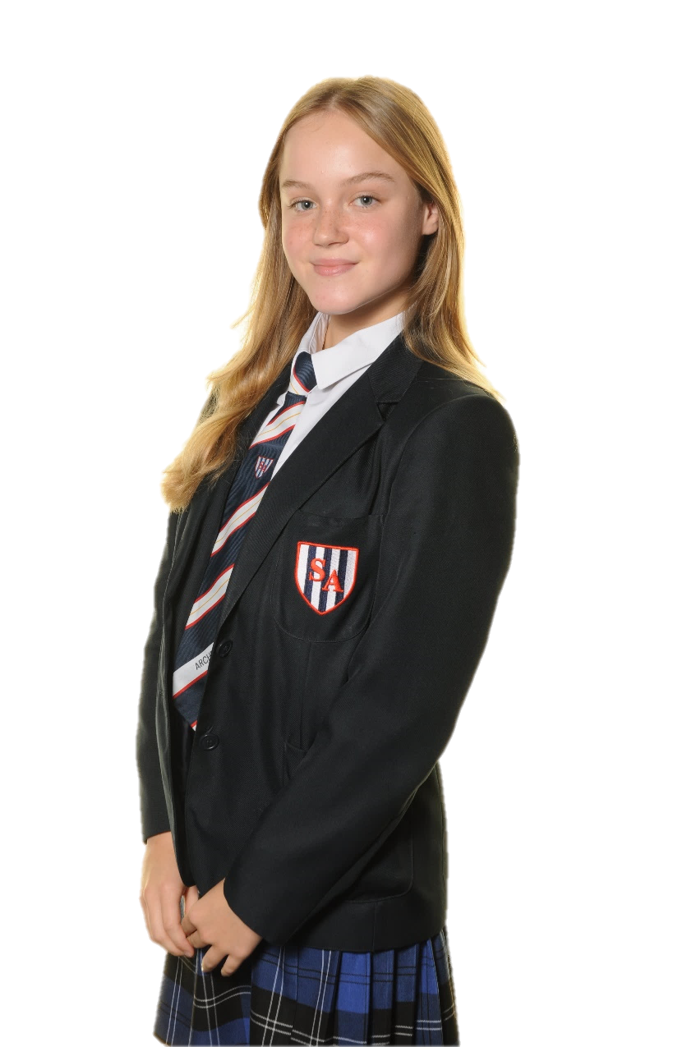
Academy Uniform
White shirt/blouse
Academy tie
Academy grey trousers
Academy kilt – at the knee
Academy blazer with Academy logo on breast pocket
Academy sweater/cardigan (optional)
Black socks/black tights
Black plain shoes of a suitable design
PE kit
Be Brave, Be Kind, Be Proud
Notes:
Standard white collared shirt- Shirts must be worn with Academy tie, tucked into trousers or kilt.
Tie - Academy clip on tie to be worn with top button fastened at the neck.
Academy grey trousers-Must not be tight, skinny or stretch lycra. They must be loose and not tight at the ankle.
Academy kilt - Worn below the knee. Must not be rolled over at the waist. Worn with black knee high socks or tights.
Blazer-To be worn at all times around the Academy
Sweater or Cardigan- Optional. To be worn in addition to blazer and not in place of.
Socks- Socks must be black. When wearing a kilt socks must be knee length or replaced by black tights. No other variation for socks is permitted.
Footwear- Black plain shoes of a sensible design. Pumps, training shoes, boots, or ankle boots, shoes with deep tread soles or with a logo or reflective design are not allowed

Slide 12
Uniform general
Smart hair styles
Purposeful hair accessories e.g. band to keep hair out of face
In braided hair black or navy blue beads.
One set of plain (gold or silver) studs
A watch
No make up
No false eyelashes
No nail varnish or any form of false nails
Be Brave, Be Kind, Be Proud
Notes:
No totally, partially shaved, or decorated scalps including shaved lines
Brightly coloured hair dyes
Deliberate shaved cut into the eyebrow
No bows on head bands/scarves
No Diamond, pearl or alternatively shaped studs
Hooped earrings
Ear stretchers
Rings, bracelets and necklaces
Body piercings including nose studs/rings, tongue/eyebrow

Slide 13
Religious Considerations
Hijab | May be worn but only in a plain and neutral in colour
Kara | One bangle may be worn
Kirpan | Baptised Sikhs are permitted to carry a kirpan, this must be declared to Head of Year.
Turban/Patka | May be worn but only in a black or navy blue colour
Mosque hat | May be worn but only in a black and navy blue colour
Be Brave, Be Kind, Be Proud

Slide 14
Uniform Sales
Gogna
Sunday 21 July 11-2pm Academy theatre
Pre-loved/second hand
Monday 22 July 10-12pm Community entrance (outside 1-2.30pm theatre)
Be Brave, Be Kind, Be Proud

Slide 15
Academy Essential Equipment
All students are expected to carry the following items with them:
Academy rucksack – purchased from the Academy
Academy water bottle – purchased from the Academy
Student planner – provided by Academy
Student name badge – provided by Academy
Pencil case containing essential equipment
Kit for days when they have PE and/or Performing Arts
Reading book
Be Brave, Be Kind, Be Proud
Notes:
Rucksacks and Academy bottles will be purchasable for £10.
This can be provided on the induction days to ensure they are available to hand out on the first day in September.
A letter will be provided this evening.

Slide 16
Cashless System and Finance
ParentPay
Online or Pay Point
Restaurant payments and trips
Use of biometric imaging
Activation letter will be posted before September
Sandwell Academy will support genuine requests for financial support on a means tested basis
Parents that requested financial assistance have been contacted by Miss Baker – Student Support & Welfare Officer
Free School Meals – new applications must be made through Sandwell MBC
Be Brave, Be Kind, Be Proud

Slide 17
First week arrangements
Wednesday 4 September – Year 7 and 12 only
Thursday 5 September – Whole school
Be Brave, Be Kind, Be Proud
Notes:
Year 7 will begin on Wednesday 4 September.
They will spend their day learning the Academy routines, getting to know their Personal Tutor and PT group and participating in some team building activities.

Slide 18
Attendance and Behaviour
Mrs Chapman
Deputy Headteacher
Be Brave, Be Kind, Be Proud

Slide 19
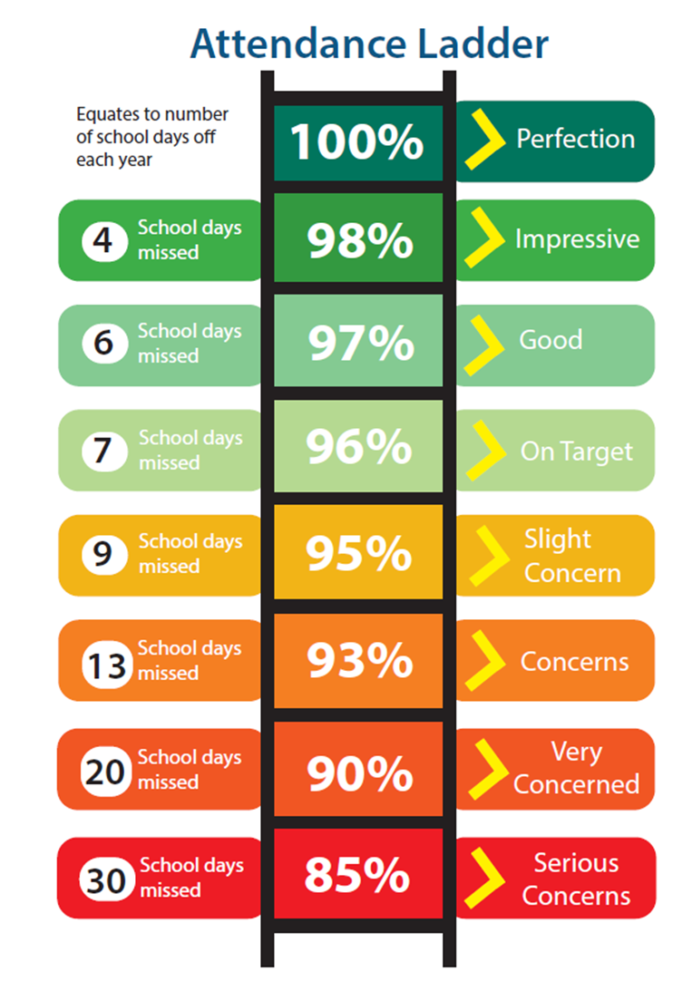
Attendance
Students are expected to have an attendance of 96% or above.
<96% PTs meeting
<93% AHOY meeting
<90% HOY and attendance officer meeting
Be Brave, Be Kind, Be Proud
Notes:
For our students to gain the greatest benefit from their education, it is vital that they attend regularly.
It is parents legal responsibility to ensure their child attends school regularly.

Slide 20
Absence
If your child is ill
Contact our attendance team absence@sandwellacademy.com
Please do this by 8.15am.
A reason for absence must be provided, otherwise this will be marked as unauthorised.
Parents complete the ‘explanations for absence’ section of planner.
If students are feeling a bit “under the weather”, please encourage them to come in.
Other absences
We will not authorise holidays unless in exceptional circumstances.
Attending a medical or dental appointment will be counted as authorised as long as the parent/carer notifies the school 48 hours’ in advance of the appointment. A copy of the medical/dental appointment will need to be provided to the school office
Be Brave, Be Kind, Be Proud

Slide 21
Lateness and Punctuality
Poor punctuality is unacceptable.
A student who arrives late (after 8.20am) will be signed in at the late gate.
If a student receives three late events during a half term they will be issued with a Stage 1 Conduct Review.
Be Brave, Be Kind, Be Proud

Slide 22
Behaviour regulation and relationships policy
Our aim is to promote pro-social behaviours through positive reinforcement and rewards, and by explicitly teaching positive behaviours through every interaction.
Standards that are expected of students are set out in the Student Charter.
Breaches of the Student Charter are categorised as ‘misbehaviour’ or ‘serious misbehaviour’.
Six levels of the behaviour policy – proportionate and graduated response.
Approach to preventing and addressing bullying are set out in our Anti-Bullying Policy.
Be Brave, Be Kind, Be Proud
Notes:
At Sandwell Academy, our core belief is that good behaviour is not simply the absence of poor behaviour.
As such, our aim is to promote pro-social behaviours through positive reinforcement and rewards, and by explicitly teaching positive behaviours through every interaction.
When positive behaviour is maintained, staff and students feel safe and there is a positive climate for learning.
Our entire approach to behaviour is fitting with our three student-friendly aims:
Be brave
Be kind
Be proud

Slide 23
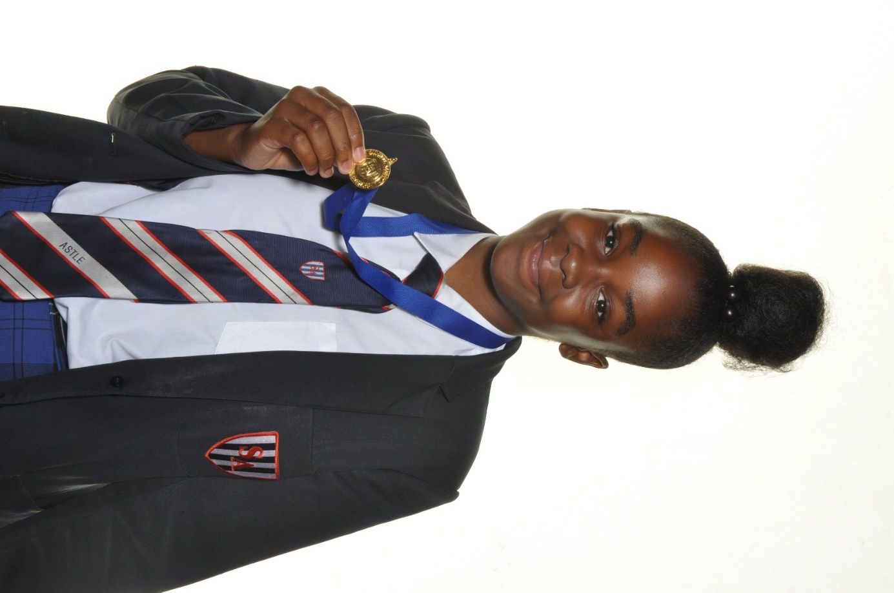
Celebrating Success
Behaviour | Praise/Reward
Positive behaviour fitting with our values | Verbal praise and ‘praise’ positive (+1)
Excellent demonstration of core value (either in lesson, or around the Academy) | Verbal praise and ‘praise’ positive (+1) + value sticker
Outstanding or continuous behaviour fitting with our values | Verbal praise and praise postcard (+5)
Stand-out academic performance or effort | Learner of the Week (+10)
Continued excellence or significant improvement | PT Star Student (+10)
Significant wider achievement | Whole-school Star Student on broadcast/website (+20)
Short term
Medium term
Long term
Postcards – Can be used to claim an immediate reward from Student Reception or saved up for a bigger reward | Value stickers – One entry into prize draw + top 20% of earners invited to termly celebration event | Praise points – contributes to awards in Bravery, Kindness and Pride + increases eligibility to trips and celebration events
Be Brave, Be Kind, Be Proud
Notes:
As an Academy we offer a range of rewards to:
Recognise the value of pupils’ achievements, progress, effort, service and leadership within the Academy
Give positive encouragement to students to succeed and to contribute
Enhance student/staff relationships within the Academy
Improve a student’s sense of self confidence and worth.
Staff are encouraged to praise verbally all positive achievements whenever opportunities present themselves.
Staff write positive and encouraging comments on postcards.
Staff praise publicly:
In front of a class
Via postcards, taken home to parents
PT star students, shared with PT group
Whole school stat student, played to whole school through weekly broadcast

Slide 24
Conduct Review
Stage | Reason | Outcome
1 | Automatically triggered when behaviour threshold met | 30 minute CR
2 | Failure to successfully complete or non-attendance to stage 1 CR | 60 minute CR
3 | Failure to successfully complete or non-attendance stage 2 CR | Day in Intervention Education Centre (IEC)
4 | Failure to successfully complete stage 3 Unacceptable behaviour in IEC | Fixed Term Suspension
Behaviour Thresholds (per half term)
1x truancy event*
3x late events
5x misbehaviour
5x disruption events in lessons (DS1)
Disruption event in lesson (DS2/3)
1x disruption at lunch time
HOY can also add suggests to CR when they breach the Academy Student Charter.
Be Brave, Be Kind, Be Proud
Notes:
Conduct reviews helps us to sustain positive behaviour across the Academy and deter students from inappropriate conduct.
Students independently complete a reflective task during their conduct review. This will focus on Academy expectations and the student charter.
If your child has a conduct review you will be informed on MCAS the day before.

Slide 25
Mobile Phones
In the event of a student being found to be using their mobile phone anywhere on the Academy grounds, the following action will be taken:
1st offence Confiscated, given back at end of day
2nd offence Confiscated, parents to collect from PT
3rd offence Confiscated, parent meeting with PT
Be Brave, Be Kind, Be Proud
Notes:
Research suggests that smart phones and the use of social media are a contributing factor to the decline in the mental health of children and young people in recent years.
In our current policy, phone use is banned, but they may present with the student (e.g., in bags).
We ask that phones are
Switched off as soon as students enter the grounds
Remain off throughout the whole school day, including in the after school session

Slide 26
Induction Days
Ms. White
Head of Year 7
Be Brave, Be Kind, Be Proud

Slide 27
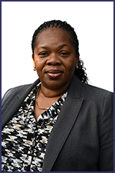
Induction Days
Wednesday 3 and Thursday 4 July
Checklist
Please support students with ensuring they are equipped (pen, pencil, ruler)
Students will learn their House and meet their PT
PE kit
Lunch arrangements
Bring money to purchase lunch from restaurant OR bring a packed lunch
Transport
Arrival for 8.15am
Arrangement with Endeavour for pick up from a coach stop
Emergency Contact
Please contact the Academy in an emergency only
Head of Year – Ms. White
Be Brave, Be Kind, Be Proud

Slide 28
Wednesday 3 and Thursday 4 July
Time | Wednesday 3 July | Thursday 4 July
8.15am | Arrival | Arrival
8.20am | Registration, move to theatre for assembly | Registration, move in sports hall
8.45am – 9.15am | Breakfast | Breakfast
9.15am – 10.05am | Head of Year welcome assembly | Session 1
10.05am – 11.20am | Session 2 | Session 2
11.20am – 11.45am | Personal Tutor session | Personal Tutor session
11.45am – 12.35pm | Lunch | Lunch
12.40pm – 2.00pm | Session 3 | Session 3
2.00pm – 2.50pm | Session 4 | Session 4
2.55pm | Theatre – review of the day | Theatre – review of the day
3.10pm | Dismissal | Dismissal
Be Brave, Be Kind, Be Proud

Slide 29
Summer (Transition) Homework
Students will be provided with transition work to complete over the summer months for:
English
Mathematics
Science
They should bring this with them on Wednesday 4 September, to hand to their Personal Tutor.
Be Brave, Be Kind, Be Proud

Slide 30
Thank you for listening
School Telephone : 0121 525 1700
Head of Year 7 Ms. White mwhite@sandwellacademy.com
Attendance Team Miss Zanib absence@sandwellacademy.com
ICT support support@sandwellacademy.com
Be Brave, Be Kind, Be Proud

Slide 31
Sandwell Academy
Be Brave, Be Kind, Be Proud

